Slide 1
Issues on developing e-commerce based business models

Slide 2
Issues on developing e-commerce based business models
Customers’ Exploding Expectations
Retailers worldwide are continuously trying to build their reputation and a sharp brand image with the promise of a great experience. It is challenging to match customer expectations in an era where experience matters the most, and tech giants like Amazon take the online buying process to the proverbial ‘next level’ with anticipatory shipping methods. Competing with these giants and matching the ever-evolving customer demands is a huge challenge for retailers today. 86% of buyers are likely to give extra money for a better experience, with a more significant 89% starting their own business and turning into competitors due to a poor experience.

Slide 3
Issues on developing e-commerce based business models
Agility Challenge
We can define Agility as the capability of a business to introduce advancements, develop and deploy digital content, and respond to seasonal changes rapidly. Agility drives immediate digital fulfillment, and it is identified as one of the most critical initiatives in eCommerce businesses. Agile transformation is at the heart of the digital business, and scaling is essential for making it successful.
Many companies find it difficult to move or change quickly to adapt to customers’ needs. This is because they cannot integrate new technologies efficiently with their existing system, and, as a result, penetration into the market gets more complicated.

Slide 4
Issues on developing e-commerce based business models
Being Consistent
Consistency is an essential element when curating a successful omnichannel strategy. Customers use numerous platforms to search for items before deciding, requiring businesses to provide smooth buying touchpoints through every product or service. However, analyzing and understanding customer interactions across all touchpoints and using them to build a consistent and smooth customer experience is one of the significant eCommerce challenges for retailers.

Slide 5
Issues on developing e-commerce based business models
Data Security
Building strong ecommerce security is critical to your company’s success. The increased use of eCommerce raises security concerns, and this is one of the most pressing eCommerce issues. Hackers and fraudsters threaten to attack the host server, steal confidential data, and introduce viruses.
Breach of credit and debit card information has become commonplace, and such lapses directly impact a consumer’s trust. Phishing is another threat hackers pose as a company and request sensitive information from their customers. Several users are increasingly concerned about the ability of eCommerce websites to protect their identity and transaction details effectively.

Slide 6
Issues on developing e-commerce based business models
Technology Partnerships
Technological partnerships are becoming popular in the eCommerce domain. Much is at stake when businesses join hands with a company to bring their idea to life. The end product can succeed by focusing on the tech or processes and giving precedence to trust, transparency, and communication between the partners.
There are obvious risks to this approach. Many businesses gravitate to choosing a partner based on costs without first setting the right expectations or understanding their work scope. These gaps lead to a disastrous collaboration and end product. But access to a vast pool of talent and technology, outsourcing can prove highly beneficial if done right.

Slide 7
Issues on developing e-commerce based business models
Customer Retention
Even some prominent players in the eCommerce segment struggle to retain their customer base. Customer-centric eCommerce challenges can be attributed to many factors such as the evolving expectation of the consumer, similar options, the failure to create a pleasant shopping experience, and sometimes the offers and discounts being more substantial on the other platforms.
Customer loyalty is indeed a determining aspect of a business’s success, and even a minor glitch from the retailer can entirely ruin the brand’s reputation. Many businesses fail to understand that retaining a user is about building a steady & rewarding relationship with them over time and employing every communication channel to materialize this relationship.

Slide 8
Issues on developing e-commerce based business models
Relevant Leads
While attracting good traffic might be achievable through promotions and other marketing efforts, getting the relevant leads remains a challenge for eCommerce businesses. It is no wonder that the average eCommerce conversion rates are often minimal. It has been reported that only 2.57% of eCommerce website visits have been converted into purchases in the world.
The efforts to convert the visitor into a user can be futile if the right audience is not accessing the website. Unfortunately, it is expected that brands fail to communicate the right message about their product or service and hence cannot engage the interested audience.

Slide 9
Issues on developing e-commerce based business models
Cyber-security
Cyber security is critical for e-commerce because cyberattacks can result in revenue, data, and overall business viability losses. When it comes to e-commerce, you must protect your data and your customers. A breach in your cyber security systems may lose your customers’ data. And that could cost your company the trust and reputation you’ve worked so hard to establish.

Slide 10
Analyzing value proposition
A value proposition stands as a promise by a company to a customer or market segment. The proposition is an easy-to-understand reason why a customer should buy a product or service from that particular business. A value proposition should clearly explain how a product fills a need, communicate the specifics of its added benefit, and state the reason why it's better than similar products on the market. The ideal value proposition is to-the-point and appeals to a customer's strongest decision-making drivers.
The term "value proposition" is thought to have first appeared in a McKinsey & Co. industry research paper in 1988, defining it as. "as "a clear, simple statement of the benefits, both tangible and intangible, that the company will provide, along with the approximate price it will charge each customer segment for those benefits."¹

Slide 11
Analyzing value proposition
What Is the Purpose of a Value Proposition?
A value proposition is meant to convince stakeholders, investors, or customers that a company or its products/services are worthwhile. If the value proposition is weak or unconvincing it may be difficult to attract investment and consumer demand.
What Is an Employee Value Proposition?
An employee value proposition (EVP) applies to the job market. Here, a company that is hiring will try to frame itself as a good place to work, offering not only monetary compensation but also a range of benefits, perks, and a productive environment. In return, the job candidate will need to convince the hiring company that they have the appropriate skills, experience, demeanor, and ambition to succeed.
What Happens if a Value Proposition Fails?
If a company cannot convince others that it has value or that its products or services or valuable, it will lose profitability and access to capital and may ultimately go out of business.

Slide 12
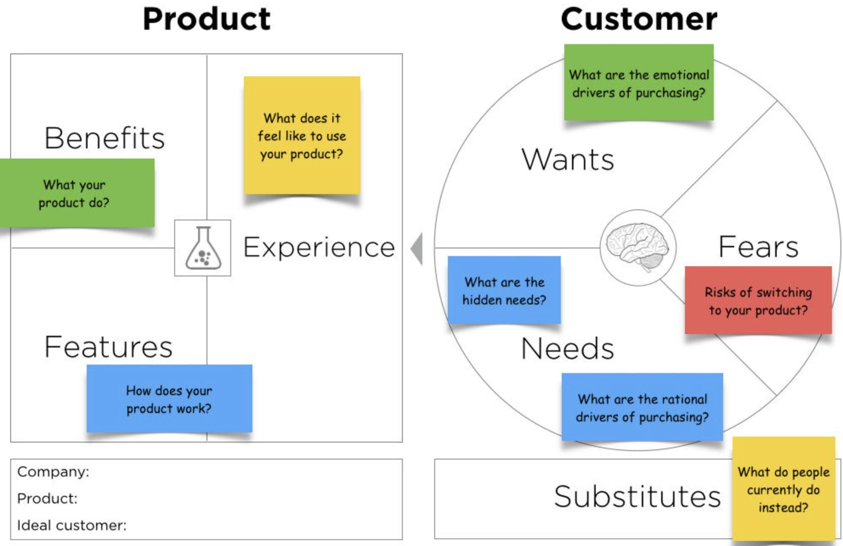
Analyzing value proposition

Slide 13
Technographic profiling
What Are Technographics?
In its broadest sense, ‘technographics’ is a shorthand term for ‘technographic segmentation’.
It’s the means of analysing statistical data, produced by a population or group, based on their ownership and usage of technology. It is a class of market segmentation such as Demographics and Firmographics.
Technographic data is a means to understanding a company’s technology stack.
What hardware and software they are using?
Which tools and applications?
How they are implementing and utilizing their varying systems and platforms?
Technographics is the next step in the development of market analysis after Demographics, Firmographics and Psychographics.

Slide 14
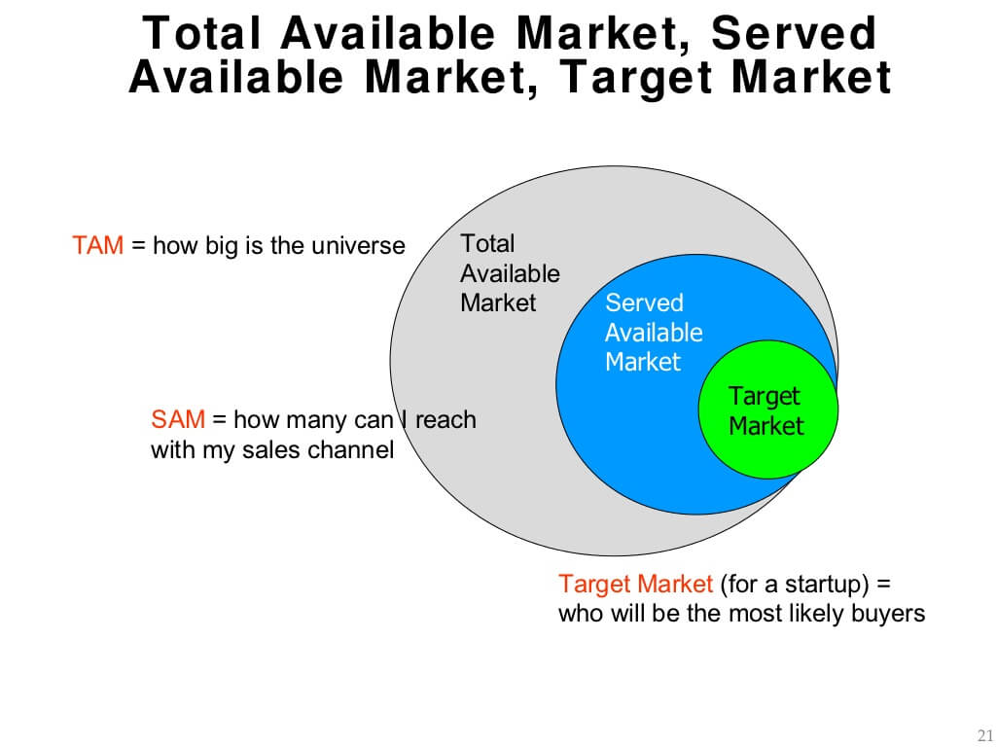
Technographic profiling
The Benefits of Technographic
Improve Sales Productivity
Total Addressable Market (TAM)
Served Addressable Market (SAM)
Target Market (TM)
Reveal New Opportunities
Improve Account-Based Marketing Campaigns
Improve Customer Retention

Slide 15
Technographic profiling
How to Collect Technographic data
Phone or email surveys
Data scraping
Buy technographic data

Slide 16
case studies in e- Commerce/e-Business
Increase Conversions with Compelling Copy
Build Powerful Backlinks to Your Online Store
Create Content for Each Stage of Your Funnel
Recover Abandoned Carts with a Twist
Make the Most of Your Customer Reviews
Create an Irresistible Unboxing Experience
Turn One-Time Shoppers into Repeat Customers

Slide 17
Impact of ICTs based implementations on traditional
business models on some verticals
Traditional business models are no longer sufficient to tackle fierce global competition. In order to survive in global competition, organizations need different business methodologies that can help them to cut costs, improve the quality of products and services, and create value for the businesses. Technology has become critical in creating and sustaining competitive advantages in the global market. The increasing globalization of business has led firms to seek new, and more appropriate, organizational structures, processes, and cultures. This has required the establishment of appropriate information technology platforms to coordinate business processes and to provide coalition mechanisms. The various factors reflecting changes in competitive environments are:
Globalization of markets
Continual innovations of products and services
Buyer oriented markets
Business through cooperation, alliances, mergers, and acquisitions
Virtual enterprises—new form of organization
New business models
Higher quality expectations
Demanding customers—customers are more informed and seek more information
New products and services

Slide 18
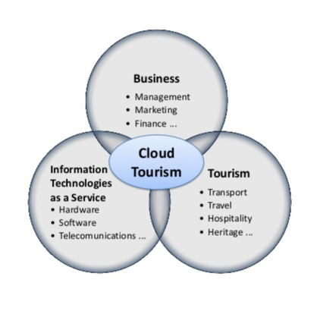
Impact of ICTs based implementations on traditional
business models on some verticals
travel

Slide 19
Impact of ICTs based implementations on traditional
business models on some verticals
travel, entertainment and hospitality industries

Slide 20
Reference
https://www.investopedia.com/terms/v/valueproposition.asp#:~:text=The%20proposition%20is%20an%20easy,similar%20products%20on%20the%20market.
https://demandscience.com/resources/blog/technographic-data
https://www.drip.com/blog/e-commerce-case-studies

